Slide 1
Neural Network
Lecturer: Van Khoa LE

Slide 2
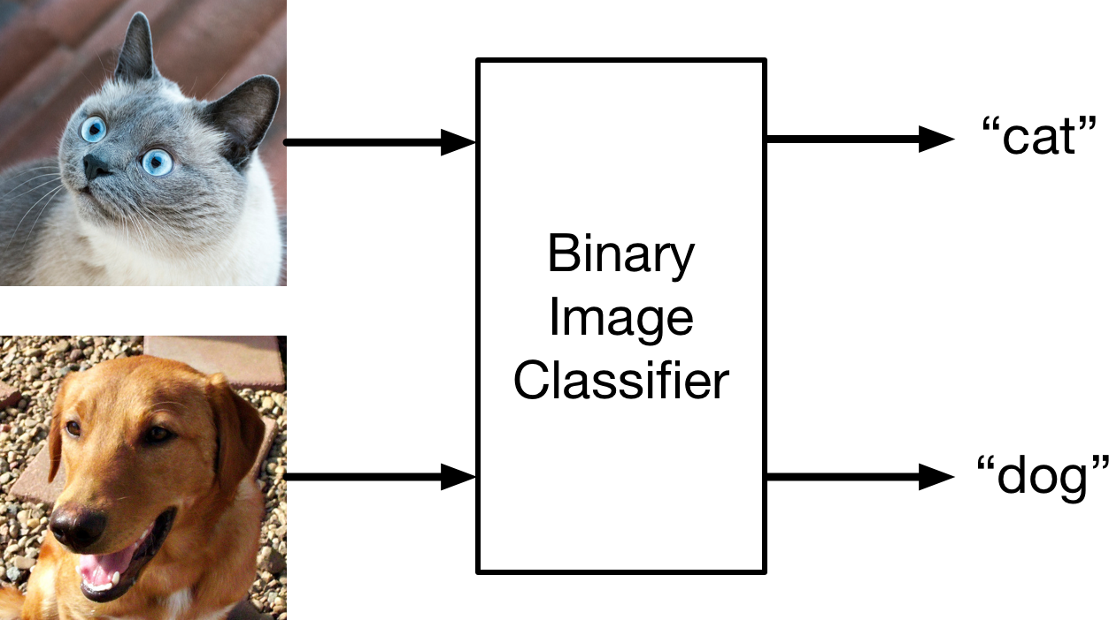
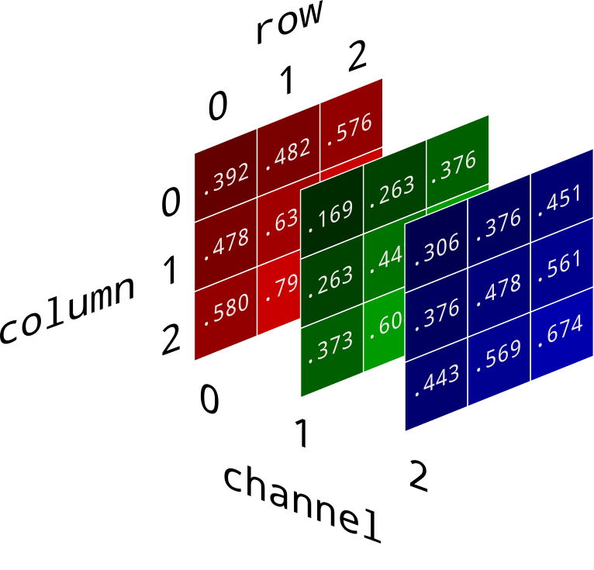
Binary classification (phân loại nhị phân)

Slide 3
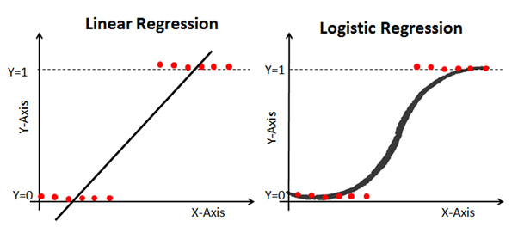
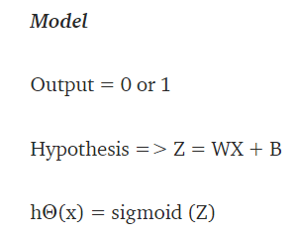
Logistic regression

Slide 4
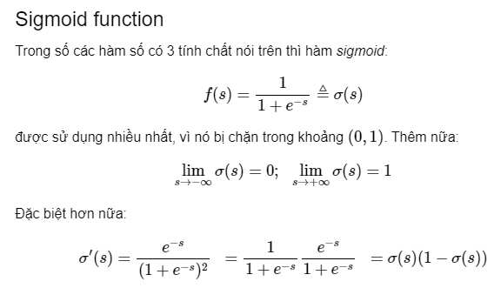
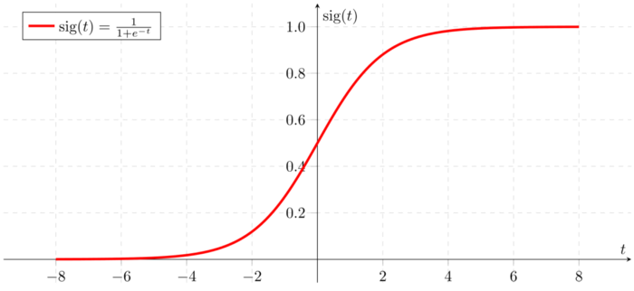
Sigmoid function (hàm sigmoid)

Slide 5


Hàm loss
Hàm loss của 1 điểm dữ liệu xi, yi, với zi = W*xi+b:
Notes:
https://machinelearningcoban.com/2017/01/27/logisticregression/
De chung minh cong thuc hay tham khao

Slide 6
Example (theory and code)
Machinelearning co ban
https://machinelearningcoban.com/2017/01/27/logisticregression/

Slide 7

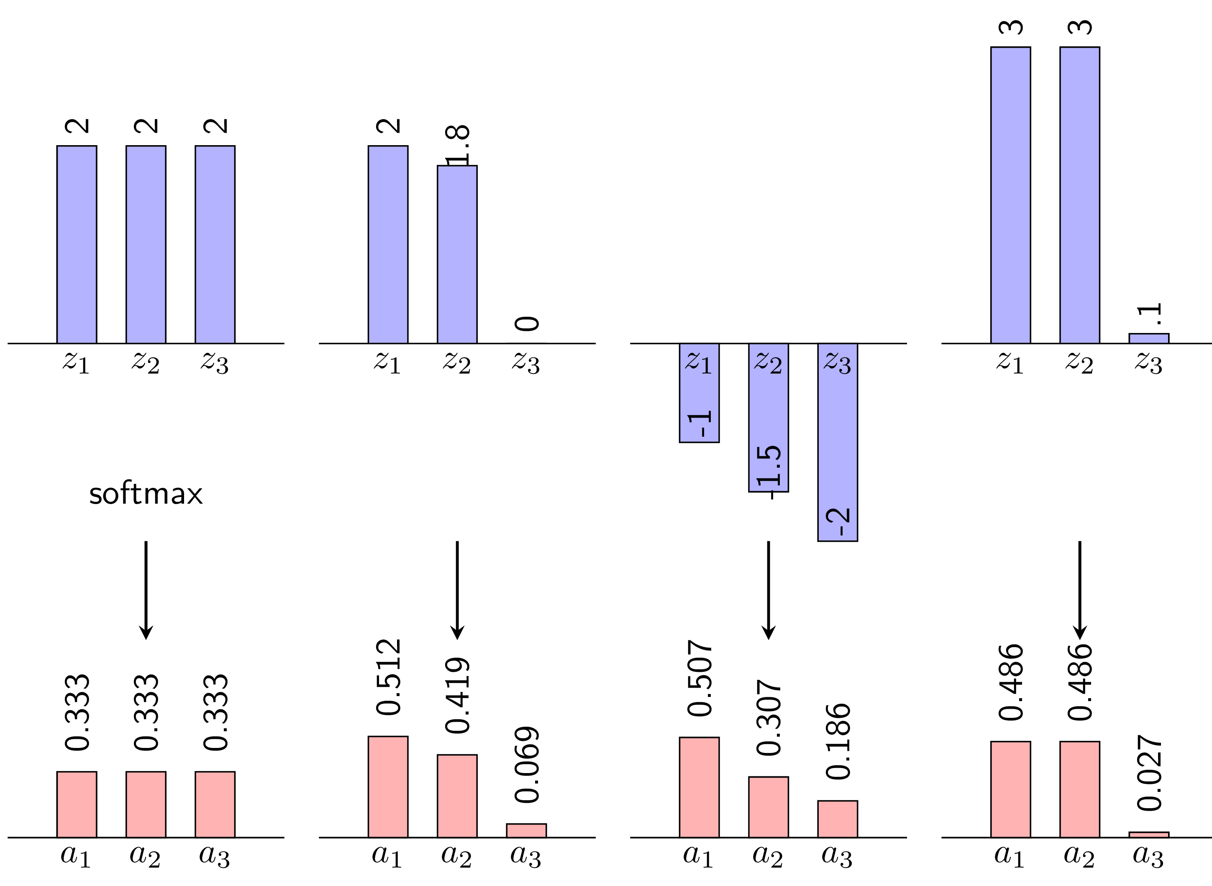
Giải quyết vấn đề nhiều lớp (class)
Không thể dung sigmoid vì đầu ra giữa các lớp không liên quan với nhau
Hàm softmax:
Hình từ machinelearningcoban.com
Notes:
https://machinelearningcoban.com/2017/02/17/softmax/

Slide 8
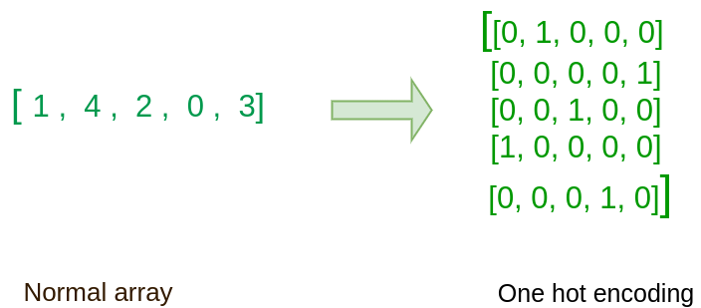
One hot encoding

Slide 9

Cross Entropy
Thêm ví dụ số

Slide 10


Hàm loss của softmax regression
Hàm loss:
Công thức cập nhật trọng số W:
Logistic regression là trường hợp đặc biệt của softmax regression khi số class là 2

Slide 11
Neural Network

Slide 12
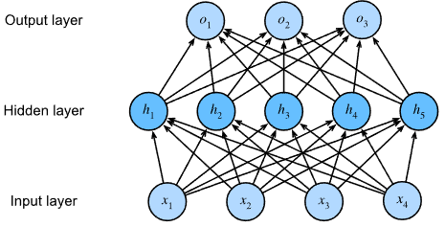
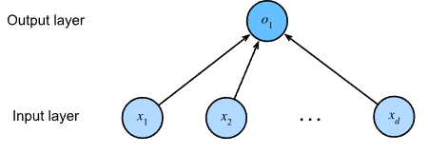
Multilayer perceptron (mạng neuron nhiều lớp)
Thêm công thức

Slide 13
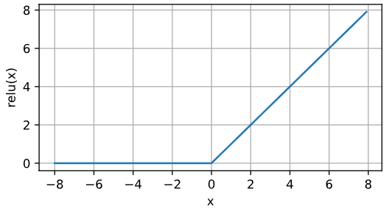
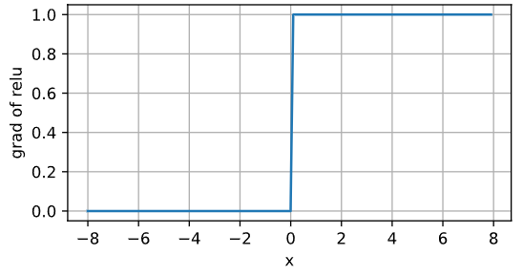
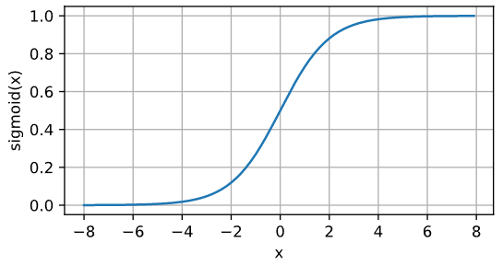
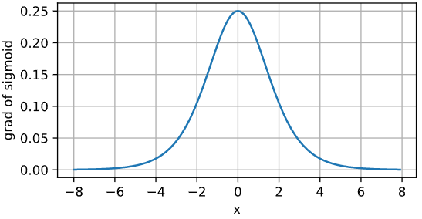
Hàm activation
Relu
Sigmoid

Slide 14
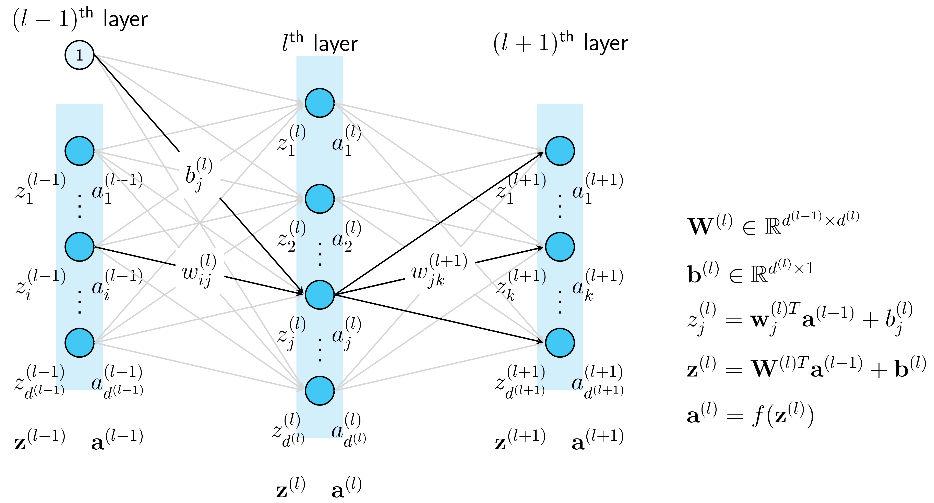

Forward propagation

Slide 15

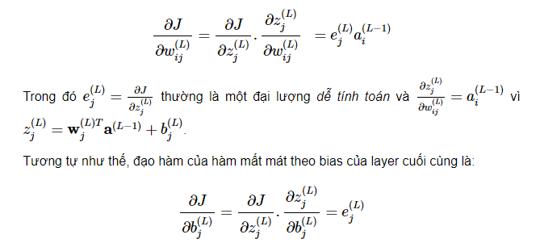
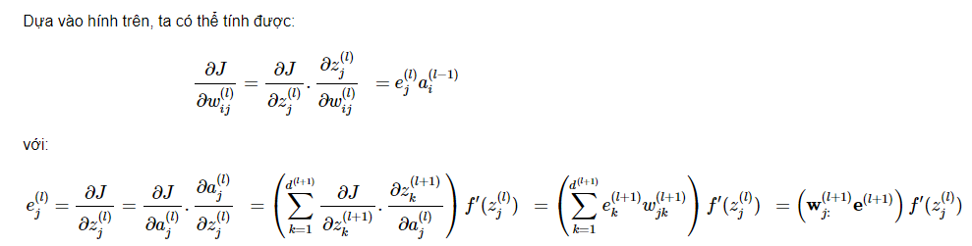
Backpropagation
Hàm loss MSE (mean square error):
Đạo hàm của hàm loss:
Notes:
https://machinelearningcoban.com/2017/02/24/mlp/
https://towardsdatascience.com/gradient-descent-explained-9b953fc0d2c
https://medium.com/geekculture/gradient-descent-simplified-631a7ce38cb6
http://neuralnetworksanddeeplearning.com/chap2.html

Slide 16
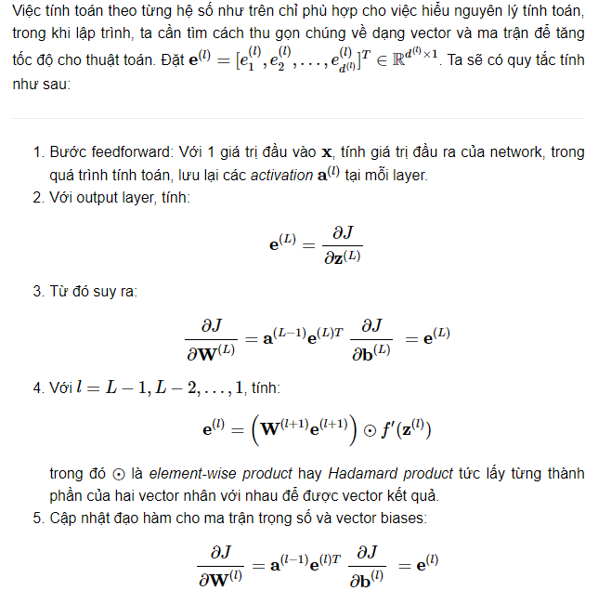
Backpropagation

Slide 17
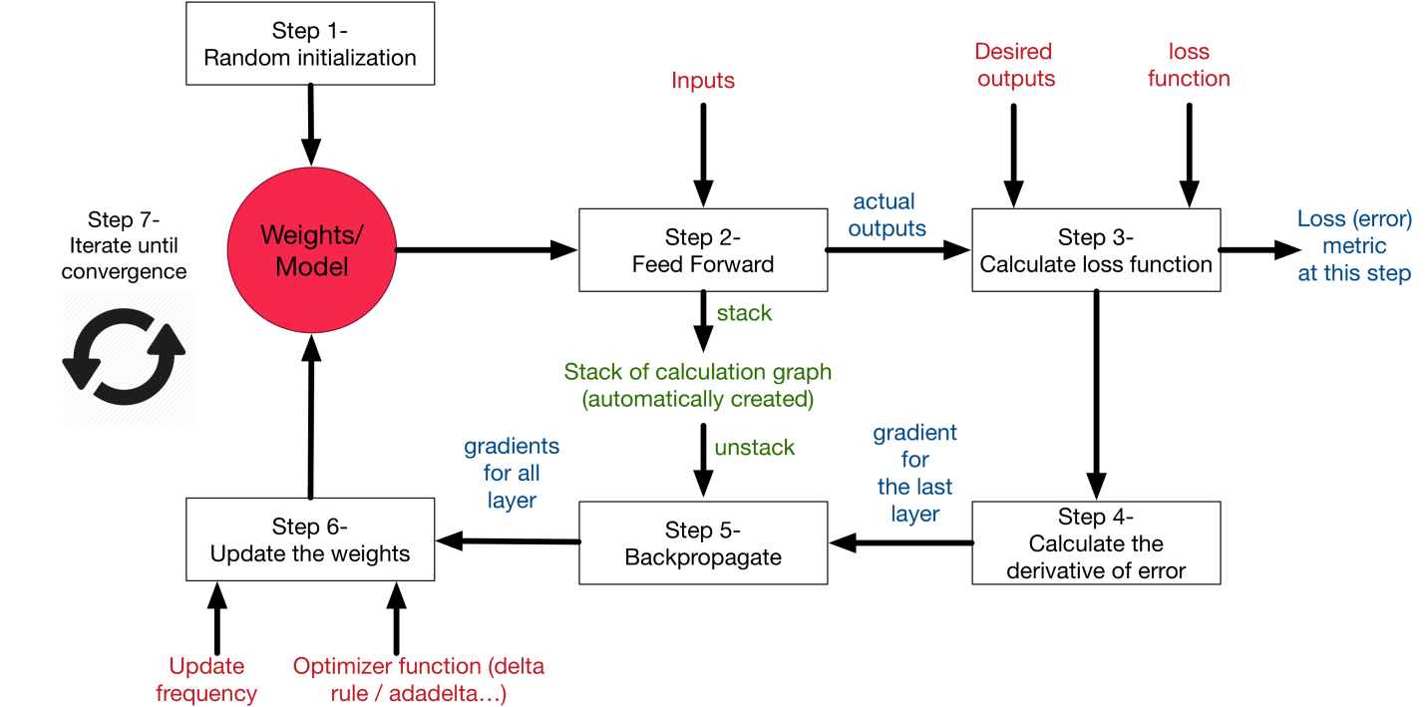
Training loop

Slide 18
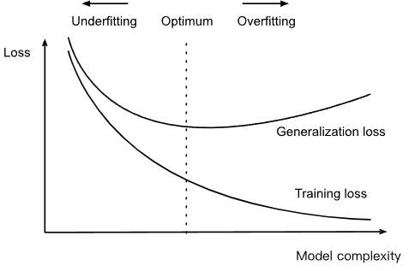
Underfit và overfit

Slide 19
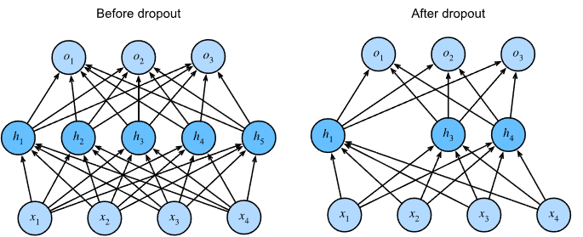

Regularization
Drop out
Weight decay

Slide 20

Splitting and cross validation
Notes:
https://scikit-learn.org/stable/modules/cross_validation.html

Slide 21
Tối ưu hoá (optimization)

Slide 22
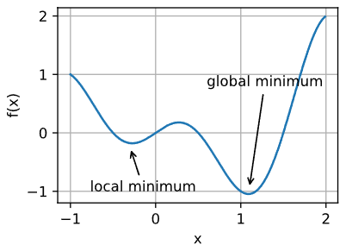
Local minima

Slide 23
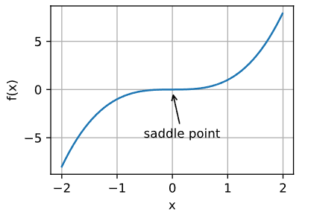
Saddle point

Slide 24
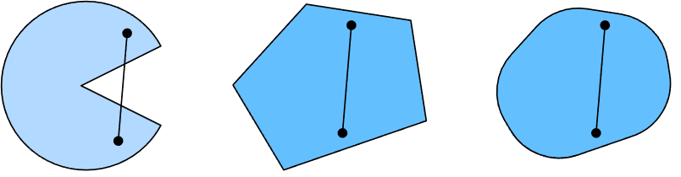
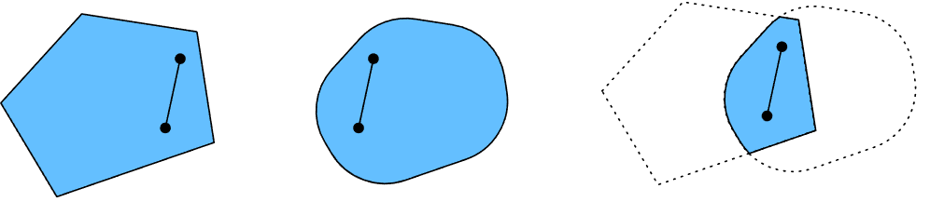
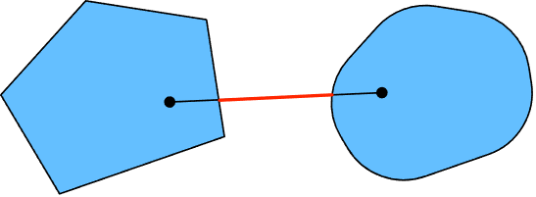
Convexity
Notes:
https://d2l.ai/chapter_optimization/convexity.html

Slide 25
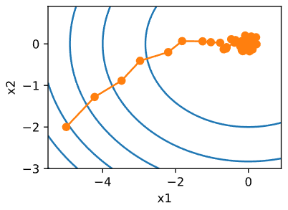
Các cách tính gradient
Stochastic Gradient Descent (SGD): Tính gradient tại mỗi thời điểm bằng cách lấy mẫu một điểm dữ liệu.
Minibatch SGD: Tính gradient tại mỗi thời điểm bằng cách lấy mẫu một nhóm điểm dữ liệu

Slide 26
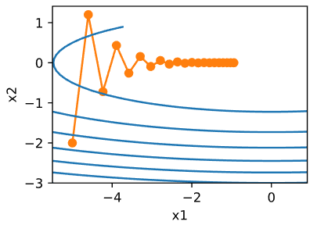

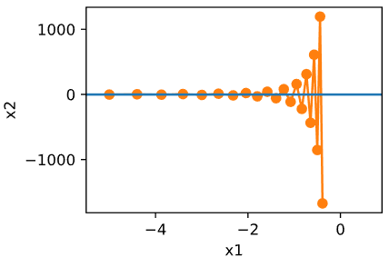
Momentum
Quay lại với hàm loss:
F min tại (0,0)
Với learning rate 0.4:
Với learning rate 0.6:
Notes:
https://d2l.ai/chapter_optimization/momentum.html

Slide 27
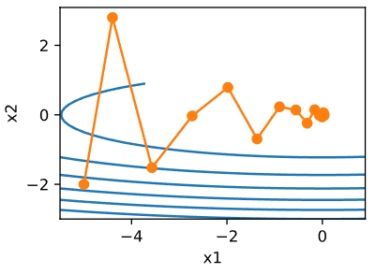

Momentum
Bằng cách cộng dồn gradient tại những thời điểm trước, hàm loss tiến tới điểm optimal với ít bước hơn:

Slide 28
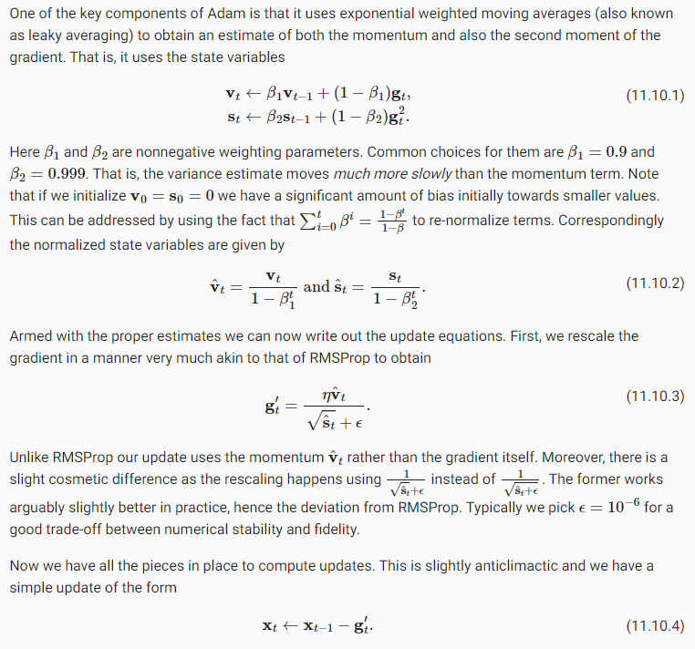
Adam
Với gradient gt, ta tính các đại lượng vt và st bằng cách cộng dồn từ những bước trước:
Momentum cũng nằm trong công thức này

Slide 29
Adam
Các đại lượng vt và st được normalize:
Gradient cuối cùng được tính theo công thức:

Slide 30

Thay đổi learning rate theo lịch trình
Theo số bước huấn luyện:
Theo hằng số:

Slide 31
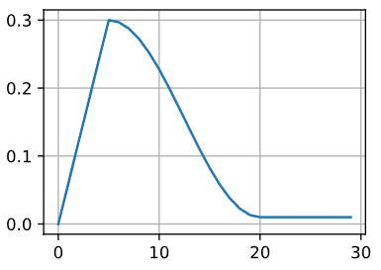
Khởi động (warm up)
Trong những bước đầu tiên, dung learning rate lớn và sau đó giảm dần

Slide 32
Practice
Image fashion dataset analysis
Logistic regression with fashion dataset
Fashion dataset with MLP
TODO: add more use case example

Slide 33
Parameter initialization
Default
Xavier
Notes:
https://d2l.ai/chapter_multilayer-perceptrons/numerical-stability-and-init.html

Slide 34
Environment and distribution shift
Covariate shift
Label shift
Concept Shift
Notes:
https://d2l.ai/chapter_multilayer-perceptrons/environment.html

Slide 35
Computation performance
Asynchronous computation
Automatic parallelism
Notes:
https://d2l.ai/chapter_computational-performance/async-computation.html

Slide 36
Vanishing Gradients
The model will improve very slowly during the training phase and it is also possible that training stops very early, meaning that any further training does not improve the model.
The weights closer to the output layer of the model would witness more of a change whereas the layers that occur closer to the input layer would not change much (if at all).
Model weights shrink exponentially and become very small when training the model.
The model weights become 0 in the training phase.

Slide 37
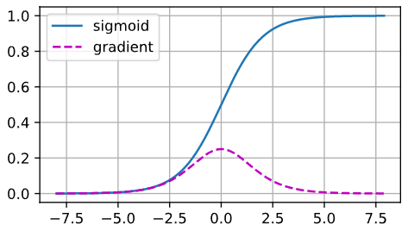
Vanishing Gradients

Slide 38
Exploding gradient
The model is not learning much on the training data therefore resulting in a poor loss.
The model will have large changes in loss on each update due to the models instability.
The models loss will be NaN during training.
Model weights grow exponentially and become very large when training the model.
The model weights become NaN in the training phase.
The derivatives are constantly

Slide 39
Solution
1. Reducing the amount of Layers
This is the solution could be used in both, scenarios (exploding and vanishing gradient). However, by reducing the amount of layers in our network, we give up some of our models complexity, since having more layers makes the networks more capable of representing complex mappings.
2. Gradient Clipping (Exploding Gradients)
Checking for and limiting the size of the gradients whilst our model trains is another solution. Going into the details of this technique is beyond the scope of this article, but you can read more about gradient clipping in an article by Wanshun Wong titled What is Gradient Clipping.
3. Weight Initialization
A more careful initialization choice of the random initialization for your network tends to be a partial solution, since it does not solve the problem completely. Check out this article by James Dellinger - Weight Initialization in Neural Networks: A journey from the basics to Kaiming
Notes:
https://towardsdatascience.com/the-vanishing-exploding-gradient-problem-in-deep-neural-networks-191358470c11

